Slide 1
Data 557 A Wi 23: Applied Statistics And Experimental Design
Indian Stock Markets Data:
Analysis of Market Indicators
Team Members
Sagnik Ghosal
Arjun Sharma
Raman S V
Adithyaa V

Slide 2

PROJECT MOTIVATION
Intended Audience: Investors across levels of expertise.
The ability to forecast and accurately predict the future performance of stocks and indices is paramount for an investor. Stock performance is quite volatile as it can be influenced by circumstances like international events, human behavior, etc. This makes it challenging to accurately forecast or predict the direction of the market.
The motivation of this project is to evaluate the validity of some common stock market indicators in accurately predicting stock market returns. In addition, we also compare the effectiveness of investing in an index to investing in individual stocks.

Slide 3
DATA SOURCES
Stocks Data
Web scraped data from the National Stock Exchange (NSE)
Stock Data:
Daily stock archives from 2016 – 2022.
Contains information for over 1500 stocks.
Nifty50 Data:
Daily index records from 2016 – 2022.
Index of top 50 stocks from the NSE.
Pre-existing Data
Calculated Fields
- Open
- Close
- High
- Low
- Typical Price
- Total Trade Quantity
- Total Trade Value
- CCI
- RSI
- MACD
- Returns
- Rolling Returns (Mean)
- Rolling Returns (SD)

Slide 4
SPECIFIC QUESTIONS TO BE ADDRESSED
Are prominent market indicators reliable as to when one should buy or sell shares? In particular, we focus on the following indicators:
CCI (Commodity Channel Index)
RSI (Relative Strength Index)
MACD (Moving Average Convergence Divergence)
Is it a better strategy to buy and hold an index compared to buying individual shares? Analyze the risk free returns and compare it to the market returns.

Slide 5
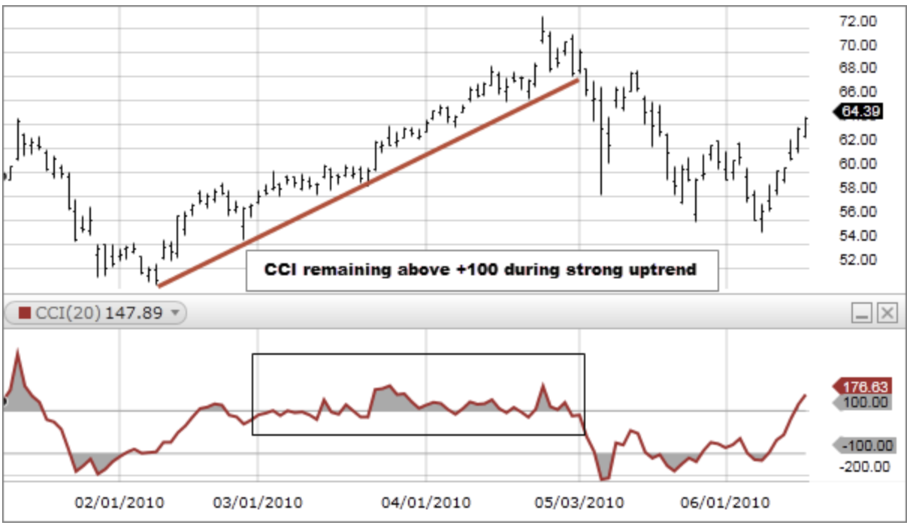
DESCRIPTION OF THE INDICATORS
CCI (Commodity Channel Index):
Helps identify potential overbought or oversold conditions in an asset price.
CCI above +100 is considered overbought and below -100 is considered oversold.

Slide 6
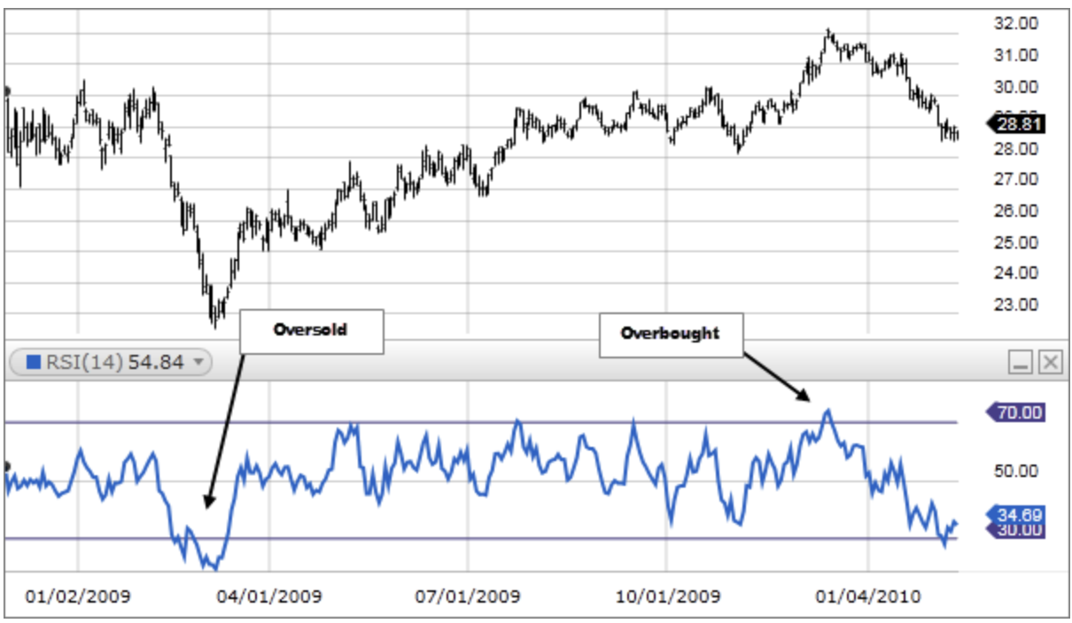
DESCRIPTION OF THE INDICATORS
RSI (Relative Strength Index):
Measures the strength of a stock's price action to identify overbought or oversold conditions
RSI above 70 is considered overbought and below 30 is considered oversold.

Slide 7
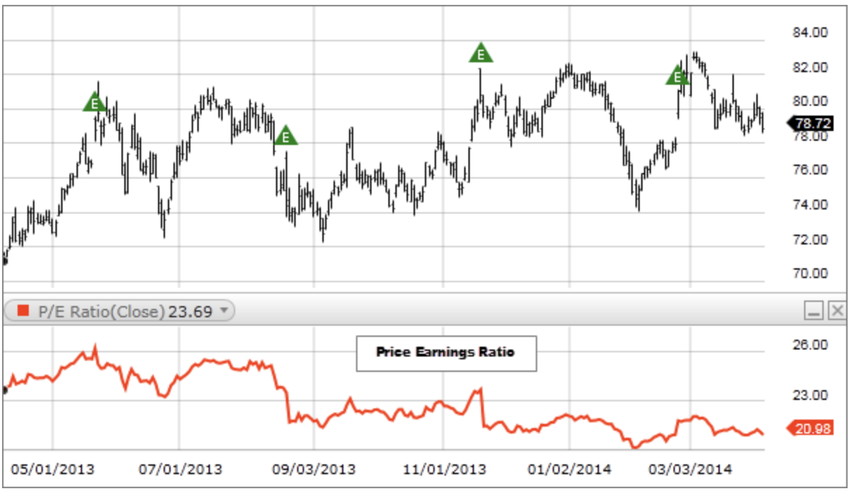
DESCRIPTION OF THE INDICATORS
PE Ratio (Price-to-Earnings Ratio):
A measure of the market's expectation of a company's future earnings growth
Doesn't consider the company's debt, earnings quality, or other factors that can impact the stock's future performance.
This is traditionally considered a core tool for fundamental analysis, but we want to analyze the impact of “buying cheap” from a technical standpoint.

Slide 8
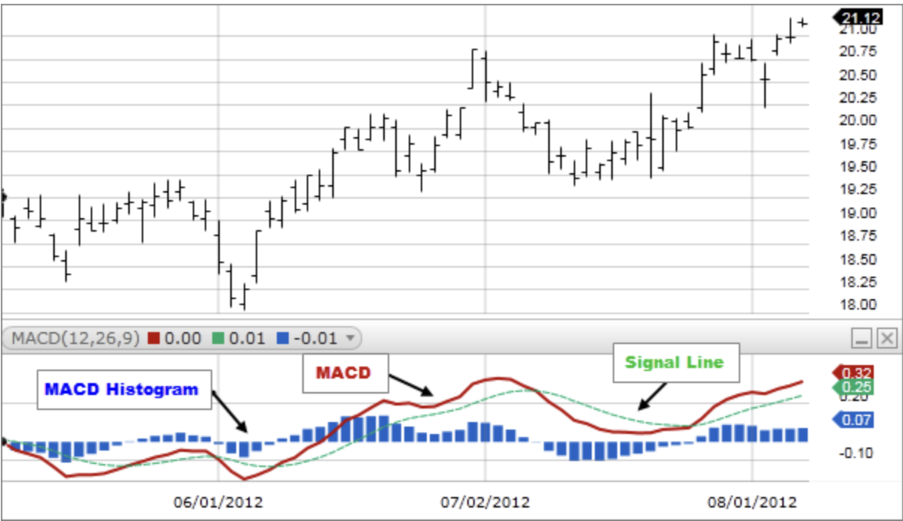
DESCRIPTION OF THE INDICATORS
MACD (Moving Average Convergence Divergence):
Identify trends and potential trend reversals in stock prices.
Calculated using two moving averages and a histogram.
A positive histogram indicates that the MACD Line is above the Signal Line, indicating upward momentum, while a negative histogram indicates downward momentum.
Analyze golden cross and death cross and if their impact is overrated.

Slide 9
Question 1 - Assumptions
Determine which factors influence the price of a stock, and their respective influence on stock performance (ANOVA)

Slide 10
REFERENCES
[1] Commodity Channel Index (CCI), Fidelity Investments: https://www.fidelity.com/learning-center/trading-investing/technical-analysis/technical-indicator-guide/cci
[2] Relative Strength Index (RSI), Fidelity Investments: https://www.fidelity.com/learning-center/trading-investing/technical-analysis/technical-indicator-guide/RSI
[3] Price to Earnings Ratio (PE Ratio), Fidelity Investments: https://www.fidelity.com/learning-center/trading-investing/technical-analysis/technical-indicator-guide/pe-ratio
[4] MACD, Fidelity Investments: https://www.fidelity.com/learning-center/trading-investing/technical-analysis/technical-indicator-guide/macd
[5] Investopedia: https://www.investopedia.com/
[6] Mallikarjuna, M., Rao, R.P. Evaluation of forecasting methods from selected stock market returns. Financ Innov 5, 40 (2019). https://doi.org/10.1186/s40854-019-0157-x

